Slide 1
The World of Soccer by Team 7

Slide 2




The World of Soccer
Soccer leagues are very popular leagues in most of European nations
The data generated by these leagues on yearly bases provides insights into each leagues performance and popularly
There are many questions we can ask to get valuable insight. Today we are going to attempt to answer a question
Does homefield advantage really exist?
Notes:
Motivates the topic
Total 1300 matches?

Slide 3
Journey to The Facts and Analysis
Weather
Each League
Audience Attendance
Game Performance since COVID19
Each League
All Leagues
All Leagues
Home & Away Games
Temp range vs. Number of wins
Temp range vs. Number of wins
Home & Away Games
Home & Away Games
Avg Goals vs. attendance
Each League
All Leagues
Attendance ranges vs. Number of wins
Percent win
Goals per match
Percent win
Goals per match
Notes:
Where the data came from
Limitation of the data that we saw

Slide 4
Data Acquisitions and Cleanup Roadmap
Each League Game worksheet
League Information
Game Score
Each League Home and Away Game data
Game Attendance
Game location
Each league Final Data sets
Weather API
Final clean up
Google Map API
Each League Final Data Set
Home Team Name
Away Team Name
Home Team Score
Away Team Score
Final Game Results
Game Date
Game City
City Lng
City Lat
Average weather during Game
Attendance
Notes:
We obtained majority of the data from various sites.
We were able to export CSV format for all data except for the Weather data
Weather data was obtained using API call
Final Data was assigned using Jupiter Notebook

Slide 5
Temperature impact on Average Goals

Slide 6
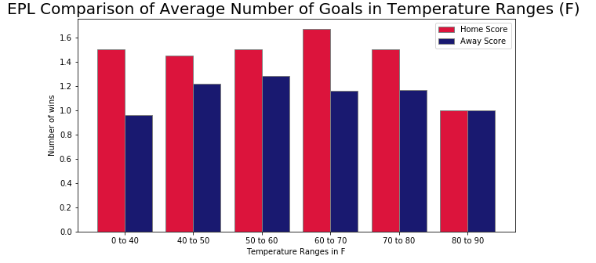
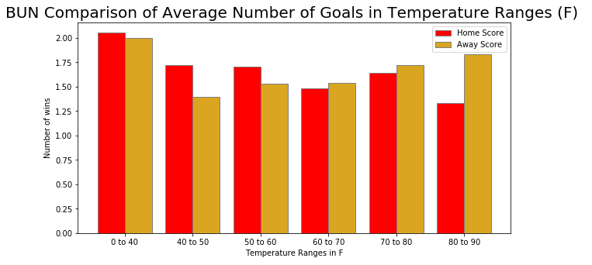
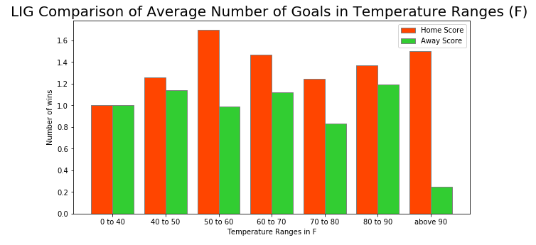
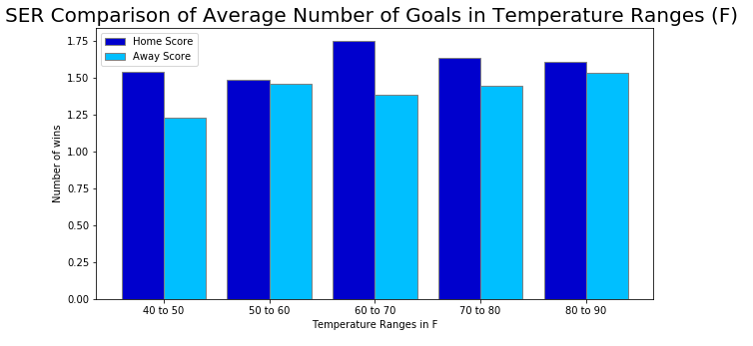
Temperature Impact on Average Goals

Slide 7
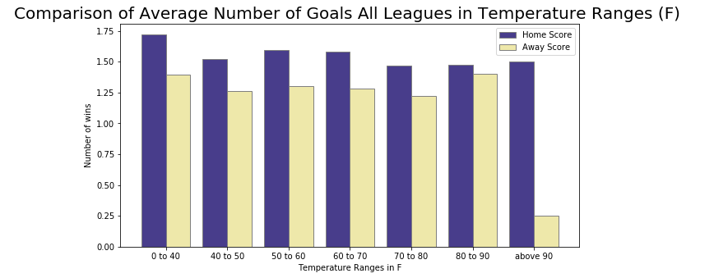
Temperature Impact on Average Goals

Slide 8
Audience impact on game

Slide 9
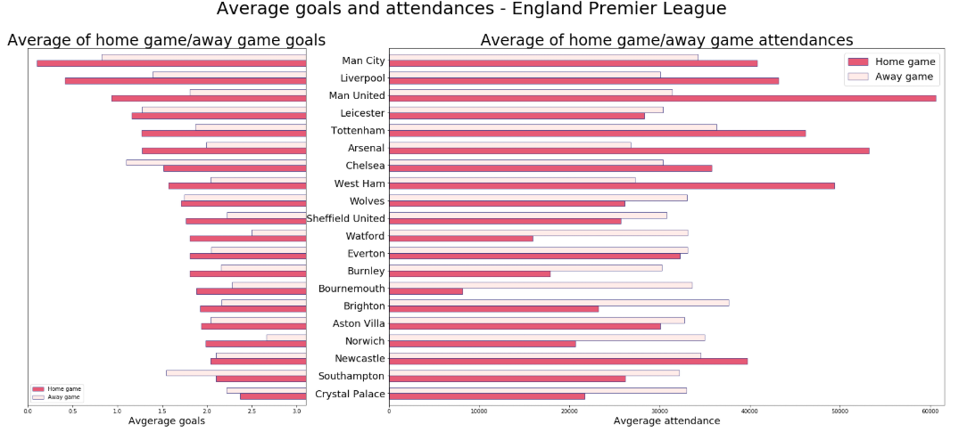
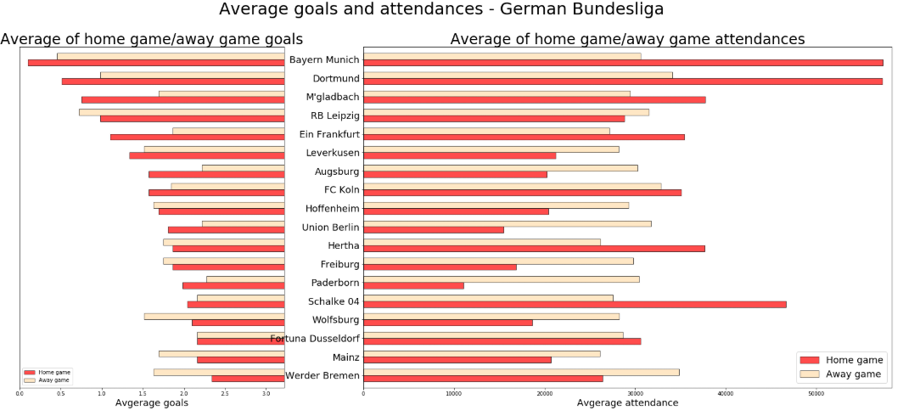
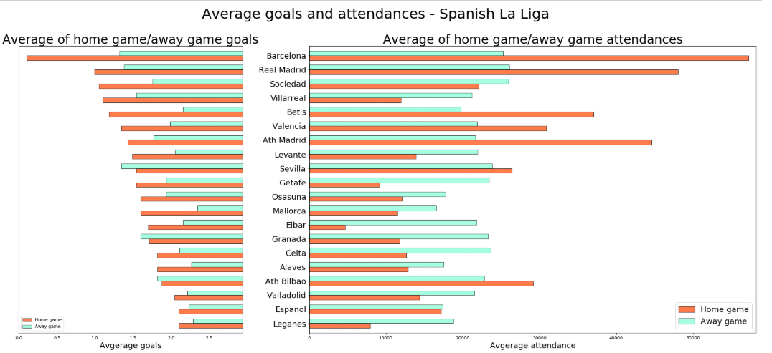
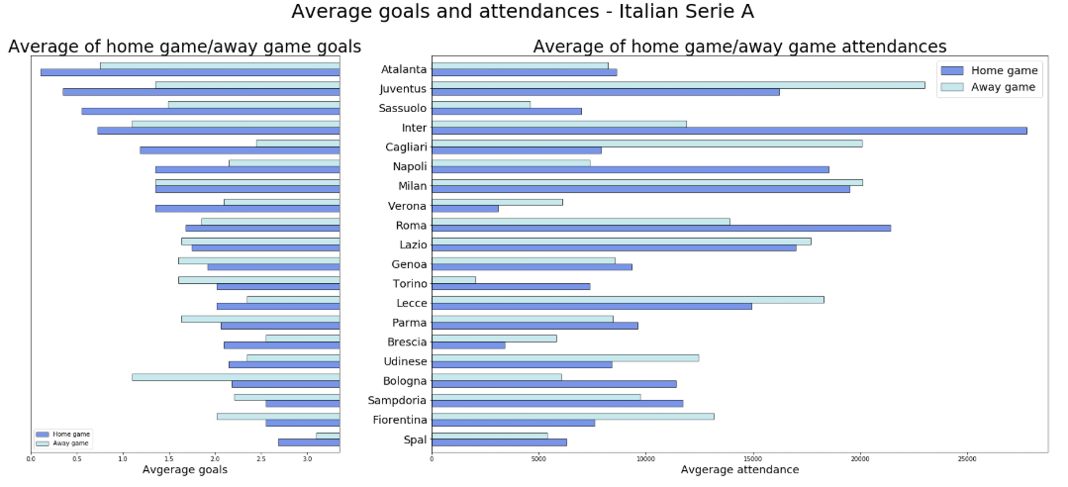
Average Scores & Attendances of Teams
Notes:
Notes:
-
Where and how did we get the data
What was found and what was assumed
Attendance data analysis
Limitation of the data
Bottom line information

Slide 10
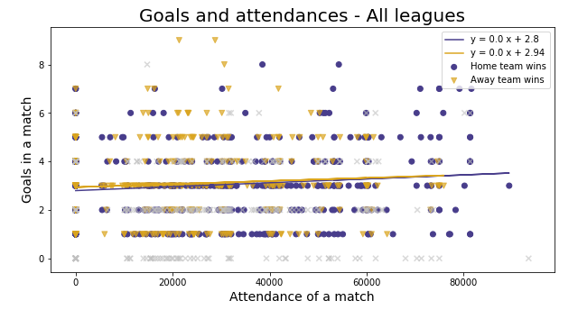
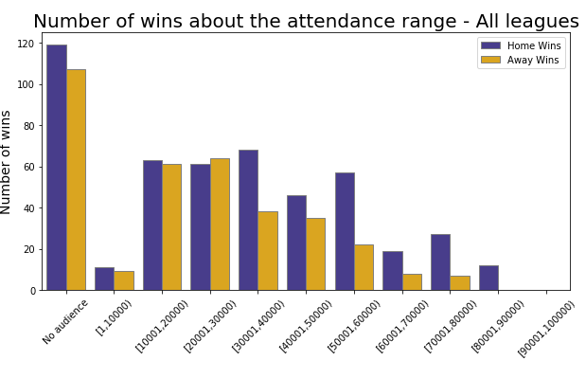
Game Results about the Attendance

Slide 11
Game Before & After COVID

Slide 12
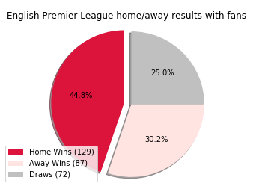
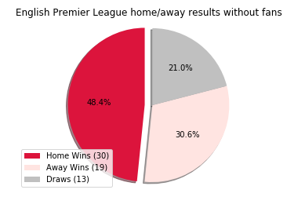
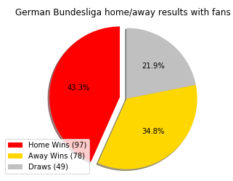
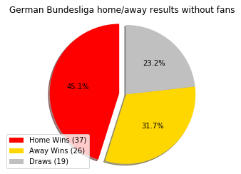
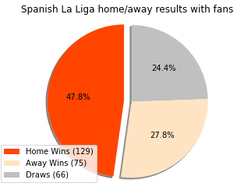
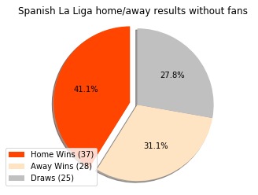
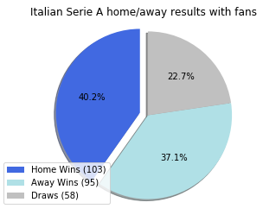
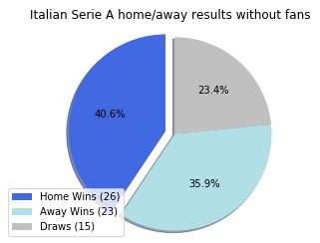
Game Results Before COVID Vs. After COVID
Games Before COVID
Games After COVID
Games Before COVID
Games After COVID
Games Before COVID
Games After COVID
Games Before COVID
Games After COVID
Notes:
Where and how did we get the data
What was found and what was assumed
Attendance data analysis
Limitation of the data
Bottom line information

Slide 13
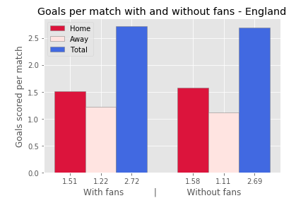
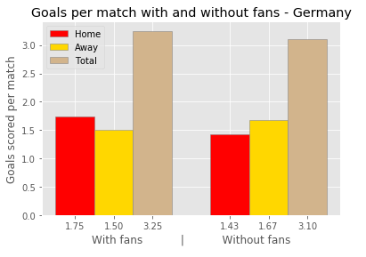
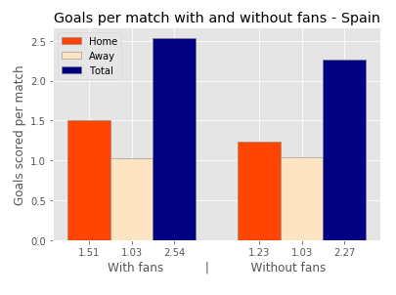
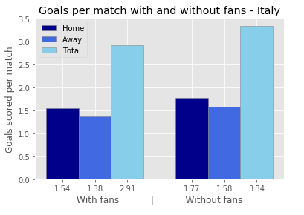
Game Results Before COVID Vs. After COVID
Notes:
Notes:
-
Where and how did we get the data
What was found and what was assumed
Attendance data analysis
Limitation of the data
Bottom line information

Slide 14
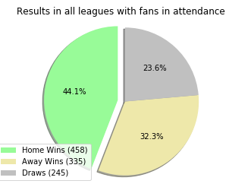
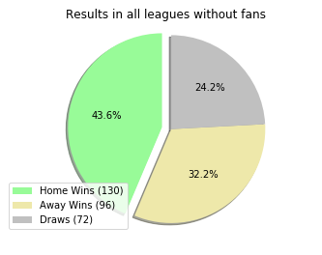
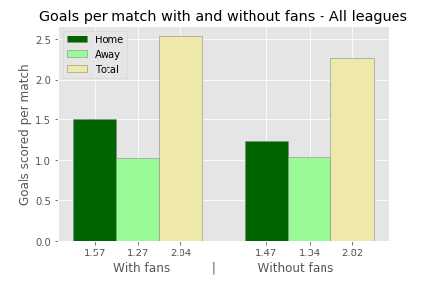
Game Results Before COVID Vs. After COVID
Games Before COVID
Games After COVID

Slide 15
Summary
Data Analysis Observations:
In extreme weather home team is more likely to score higher
In extreme heath home team is more likely to win
Not true for Germany, as temp increases away team is going to score higher
Overall home team performs better during home game regardless of audience count
The scores of matches are not affected by the size of audiences.
Lower capacity stadium games where Home and away team performs equally
Higher capacity stadium, home games performance is much higher
Three of the four leagues where home team is performing better without home fans
England home teams performs better in empty stadiums
Spain is the only league where home teams perform better with home fans
Data Limitation:
Weather limitation, average temp for the game day
Not all game attendance data were available which impacted the data pool size
Not much data available for the games after the COVID
Number of Games played after COVID are very limited
Perfect data set would have been full season schedule for normal

Slide 16
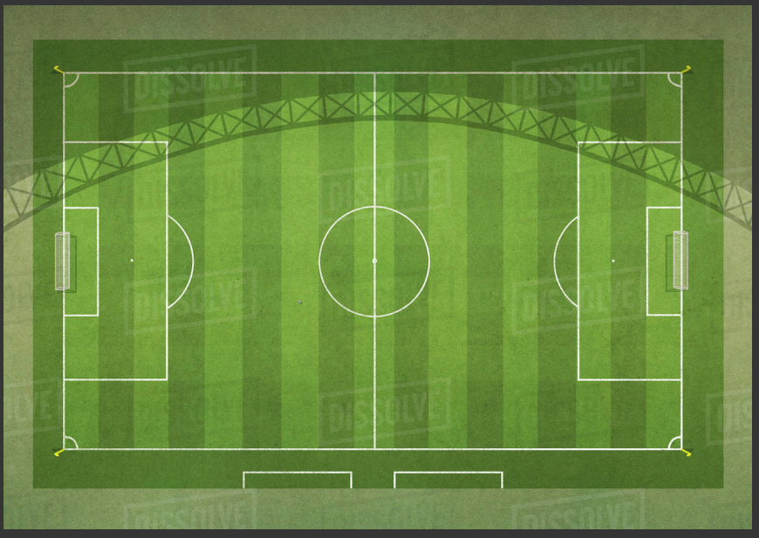
How are you going to bet on your next soccer Game?
Bet on your
HOME TEAM

Slide 17
References
Score Data
(add the data link)
Weather Data
https://www.worldweatheronline.com/developer/
https://maps.googleapis.com/maps/api/place/findplacefromtext/output?parameters
Attendances : for each league, team
https://www.footballwebpages.co.uk/fc-augsburg/attendances
Stadiums & City
https://www.stadiumguide.com/premier-league-stadiums/
https://www.bundesliga.com/en/bundesliga/news/stadiums-borussia-park-allianz-arena-signal-iduna-park-veltins-7642
https://www.football-stadiums.co.uk/leagues/la-liga/ --- and wikipedia
https://www.worldfootball.net/venues/ita-serie-a-2019-2020/

Slide 18
Thank you

Slide 19
Backup Slides

Slide 20
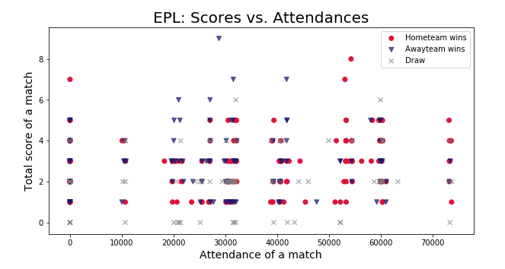
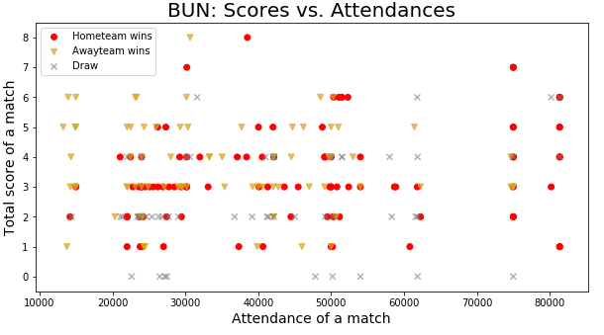
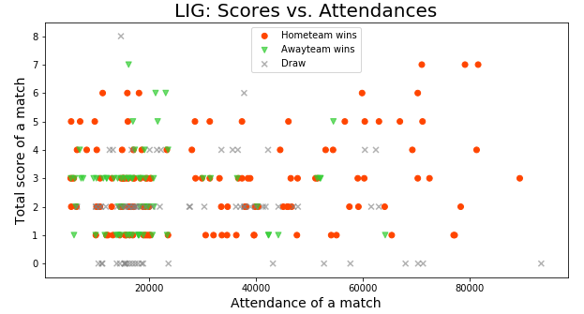
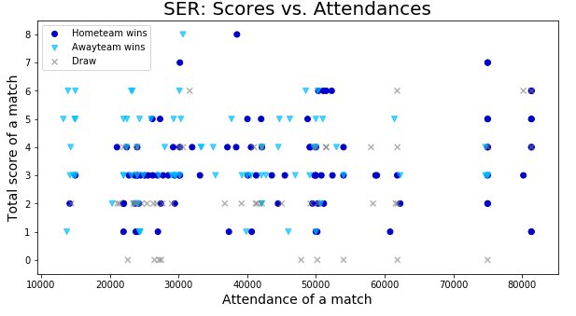
Scatter plot for all matches of match total scores and attendances

Slide 21
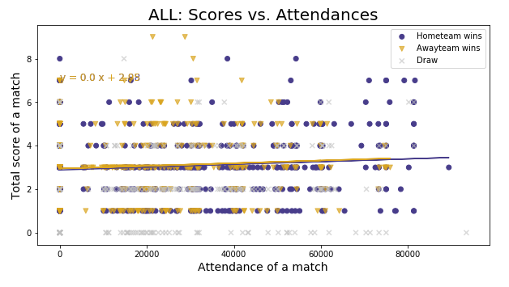

Slide 22
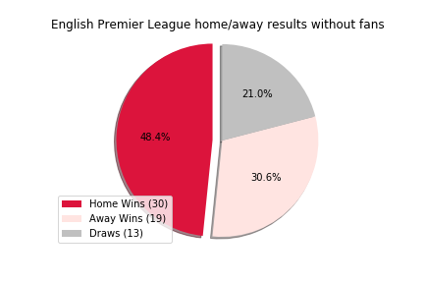
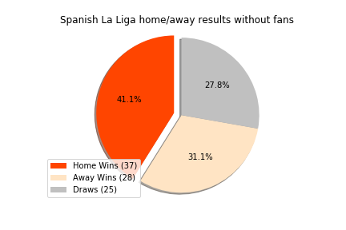
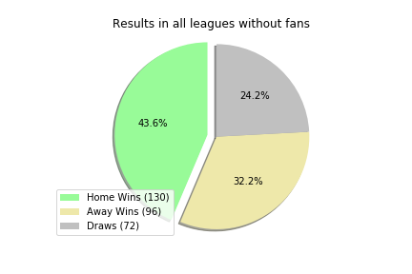
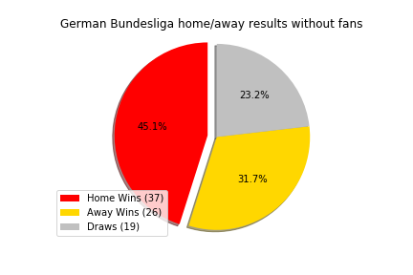
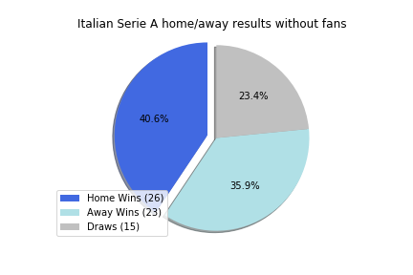
Game Before COVID Vs. Game After COVID
COVID data analysis
Limitation of the data
Bottom line information
Notes:
Where and how did we get the data
What was found and what was assumed
All of the tams before and after COVID charts
What statistically significant test should we run.

Slide 23
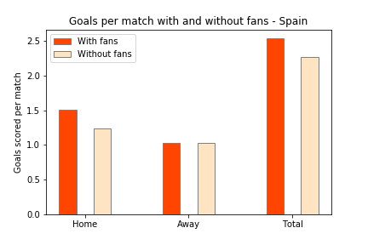
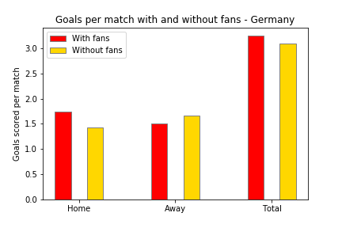
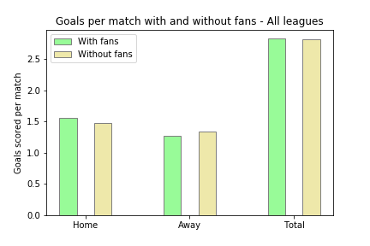
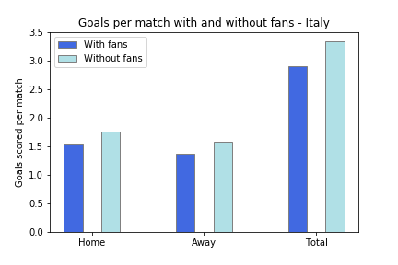
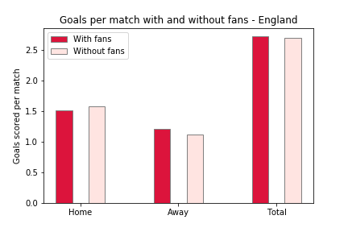
Notes:
Overall all leagues does not show the significant variance

Slide 24
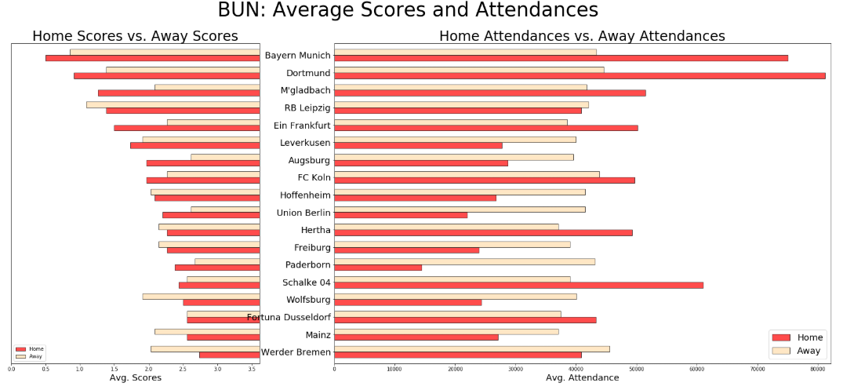
Average Scores & Attendances
The number of matches of BUN teams until 2020-06-27 is 306
The number of matches of BUN teams after COVID-19 is 82
Notes:
Where and how did we get the data
What was found and what was assumed
Attendance data analysis
Limitation of the data
Bottom line information

Slide 25
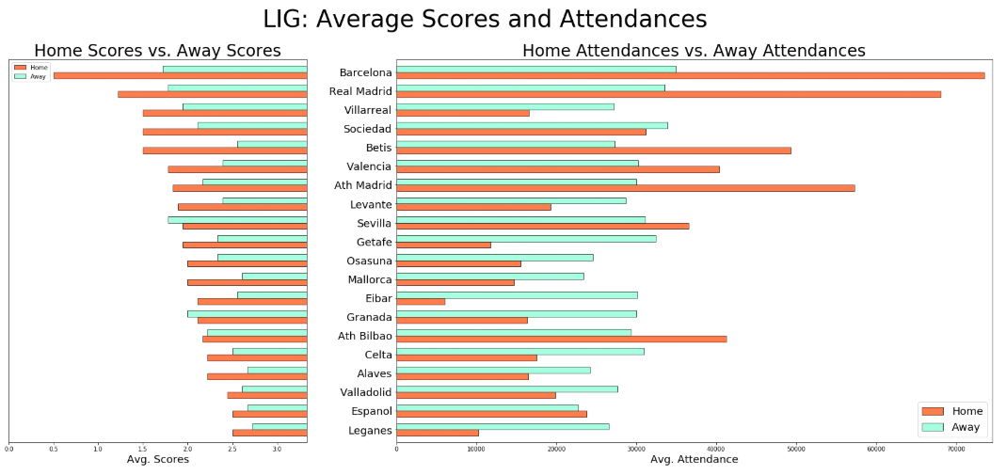
Average Scores & Attendances
The number of matches of LIG teams until 2020-07-13 is 360
The number of matches of LIG teams after COVID-19 is 90
Notes:
Where and how did we get the data
What was found and what was assumed
Attendance data analysis
Limitation of the data
Bottom line information

Slide 26
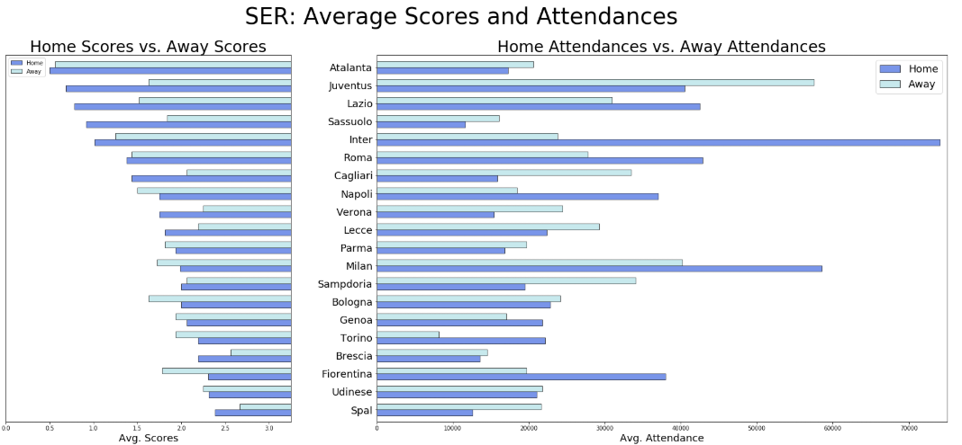
Average Scores & Attendances
The number of matches of SER teams until 2020-07-13 is 320
The number of matches of SER teams after COVID-19 is 64
Notes:
Where and how did we get the data
What was found and what was assumed
Attendance data analysis
Limitation of the data
Bottom line information

Slide 27
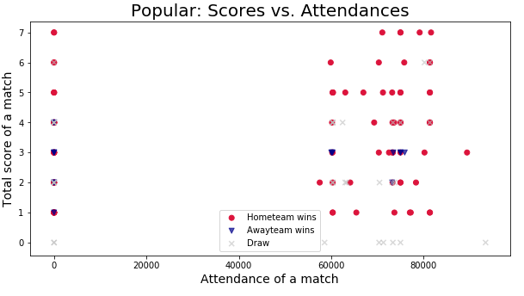
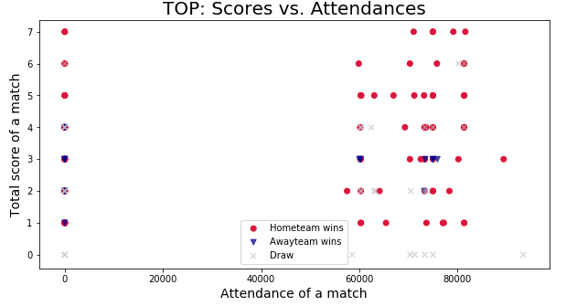

Slide 28
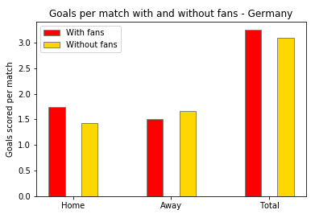
Game Before COVID Vs. Game After COVID
Games Before COVID
Games After COVID
The number of matches of BUN teams until 2020-06-27 is 306
The number of matches of BUN teams after COVID-19 is 82
Notes:
Where and how did we get the data
What was found and what was assumed
Attendance data analysis
Limitation of the data
Bottom line information

Slide 29
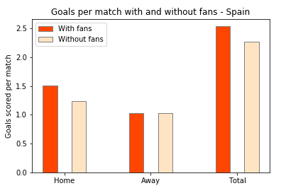
Game Before COVID Vs. Game After COVID
Games Before COVID
Games After COVID
The number of matches of LIG teams until 2020-07-13 is 360
The number of matches of LIG teams after COVID-19 is 90
Notes:
Where and how did we get the data
What was found and what was assumed
Attendance data analysis
Limitation of the data
Bottom line information

Slide 30
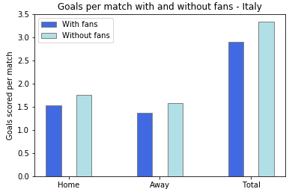
Game Before COVID Vs. Game After COVID
Games Before COVID
Games After COVID
The number of matches of SER teams until 2020-07-13 is 320
The number of matches of SER teams after COVID-19 is 64
Notes:
Where and how did we get the data
What was found and what was assumed
Attendance data analysis
Limitation of the data
Bottom line information

